Slide 1
QUALITY OF RED WINE

Slide 2
Introduction
Wine producers constantly brag about the quality ratings that their wines receive from critics, because a high wine rating — implying high quality — translates into increased sales for a wine.
But quality wines come in all colors, degrees of sweetness and dryness, and flavor profiles.
A wine’s quality is not absolute: how great a wine is or isn’t depends on who is doing the judging.
The combined opinion of a group of trained, experienced palates (also known as wine experts) is usually considered a definitive judgment of a wine’s quality.

Slide 3
The given dataset contains 10 classes which is multi class data.
For such kind of datasets classification techniques are used.
The following are the techniques applied for this dataset.
Random forest,KNN,SVM,Logistic regession and Decision trees.

Slide 4
Exploration of data
The given dataset contains 12 attributes among which 11are features and 1 is label.
The features are fixed acidity,volatile acidity,citric acid,residual sugar,chlorides,free sulphur dioxide,total sulphur dioxide,density,pH,sulphates,alcohol
The dependent variable is QUALITY which is mostly effected by alcohol.

Slide 5
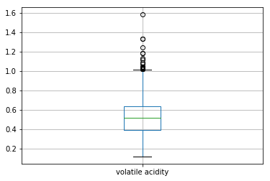
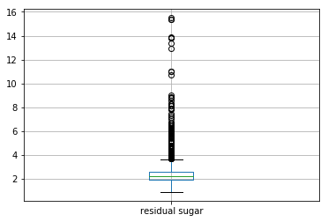
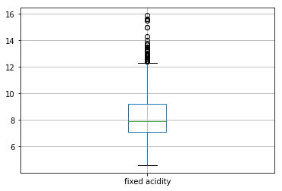
DATA VISUALISATION
Boxplots:

Slide 6
Detection of outliers
Outliers are detected using visualisation techniques.
The data contains many outliers that are deviating from the original data.
If classification techniques are applied in presence of them it effects on accuracy.
The more the outliers the lesser will be the accuracy.

Slide 7
The accuracy charts before removal of outliers
Classification technique | Accuracy in %
KNN | 67.5
Logistic regression | 57.7
SVM | 63.3
Random forest | 64.7

Slide 8
Classifying the quality
0-3 -> bad (0)
4-6 -> average (1)
7-10 -> good (2)

Slide 9
Accuracy values after classifying quality
Classification technique | Accuracy in %
KNN | 84.3
Logistic Regression | 89.7
Decision Trees | 83.7
Random forest classifier | 88.8

Slide 10
Removal of outliers
The given dataset is noisy data it contains outliers.Presence of outliers effects on accuracy so that lesser accuracy is retrieved.
Outliers are removed by replacing them with mean .
Classification techniques are applied even after removing the outliers and hence better accuracy can be obtained.

Slide 11
The above accuracy chart is for considering all the inputs .
If only the effecting features are considered then the accuracy increases
The features that effect mainly are
'fixed acidity', 'volatile acidity', 'citric acid', 'residual sugar', 'chlorides', 'alcohol'

Slide 12
Accuracy chart for after removing outliers
Classification technique | Accuracy in %
KNN | 84.3
Logistic Regression | 89.1
Decision Trees | 81.2
Random forest classifier | 93.85

Slide 13
Conclusion:
The highest accuracy is 93.85% splitting the data
Under train data 90% and test data 10%.
The random state is 6 and no of features considered are 6.
If entire data is trained and only 20% of data is tested then the accuracy of 99% is retrieved.

